Slide 1
SPACE BROOM
By Yassen and Dimitur

Slide 2
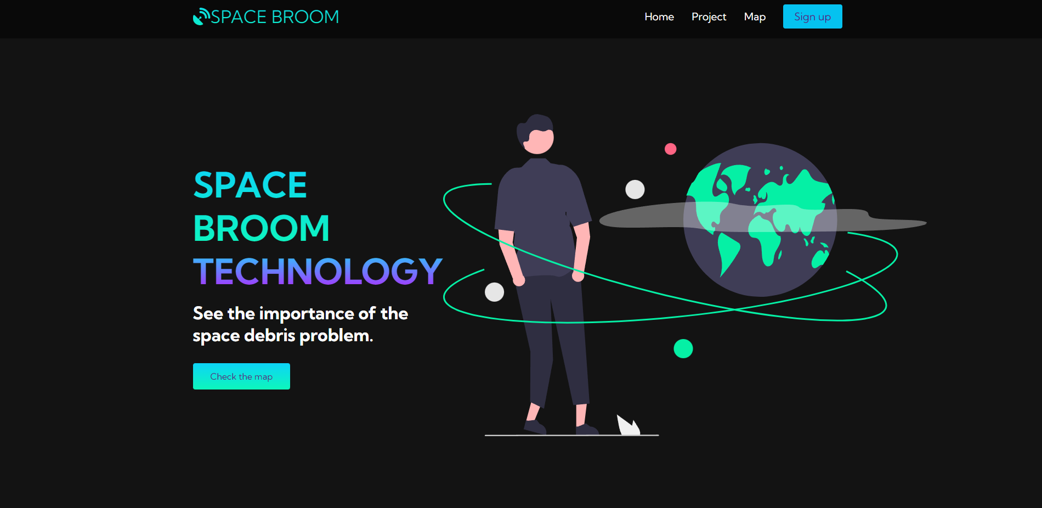
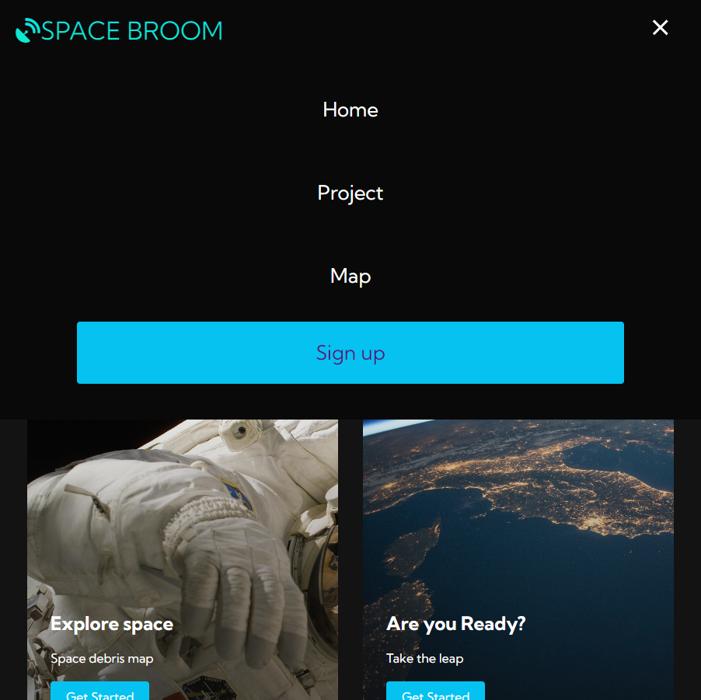
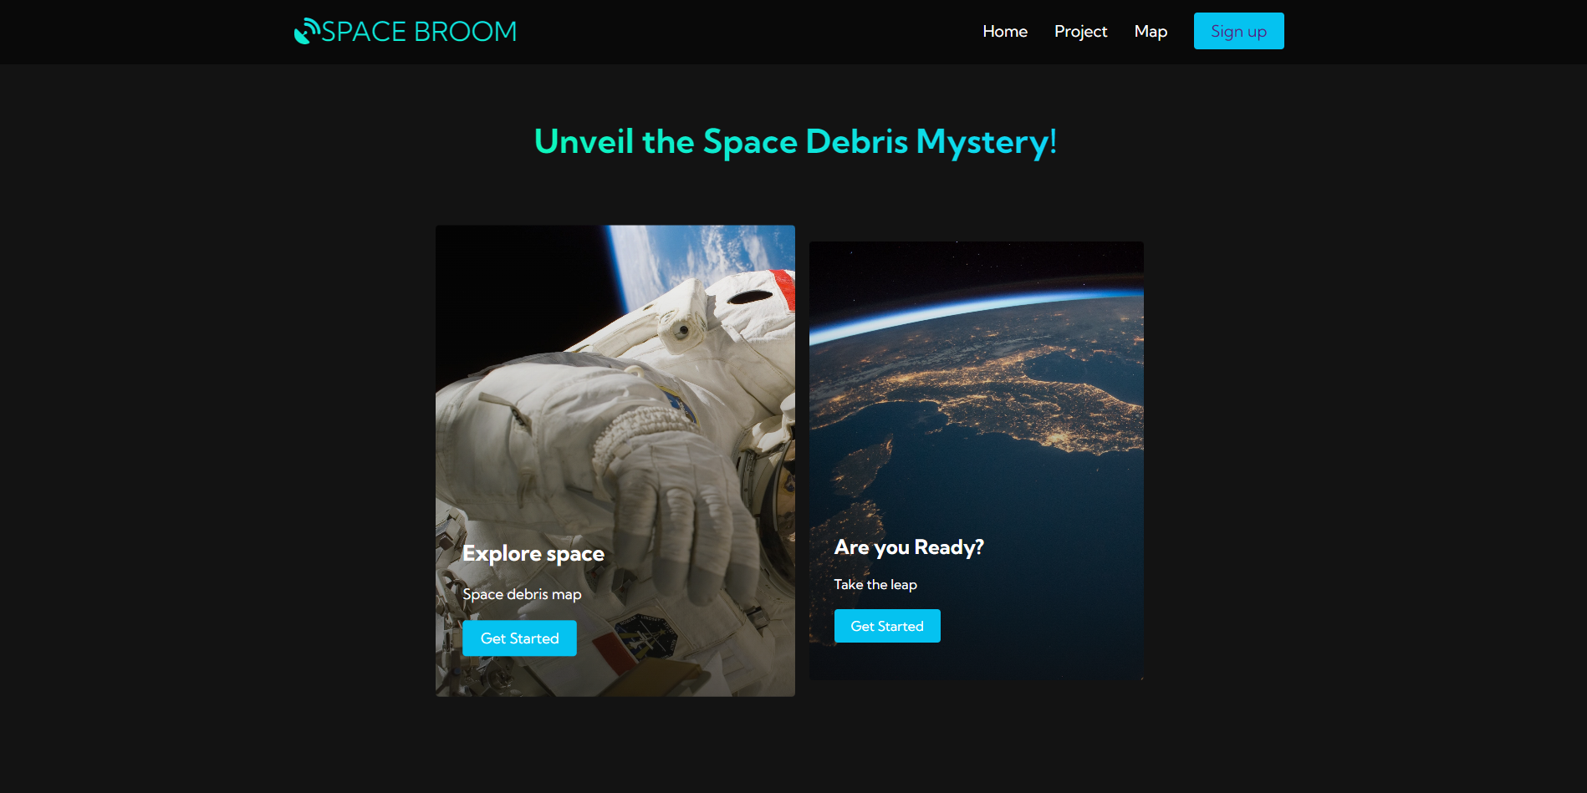

Main page
Тhis is our main page. At the top you can see 4 buttons. Project directs you to a page where we explain about the space debris problem. If you click on map you will be able to see the 3D earth and space debris map. If you make the page smaller a navigation bar appears so that everything can fit. The sign up button is still being worked on.

Slide 3
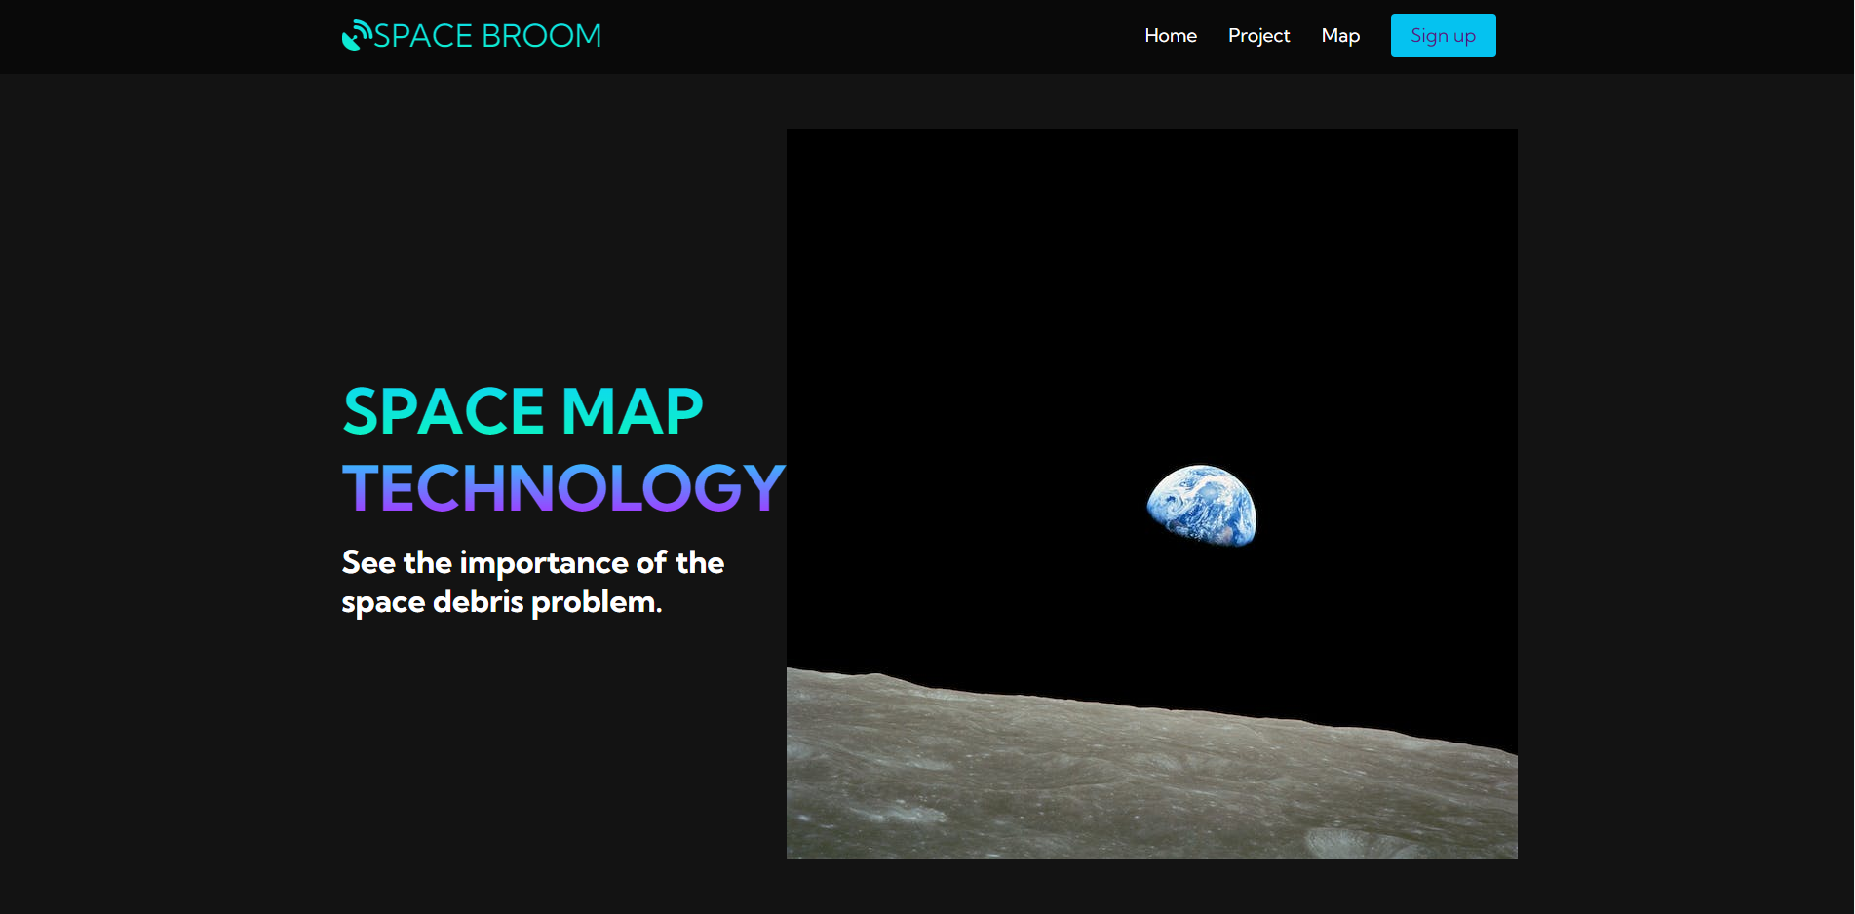
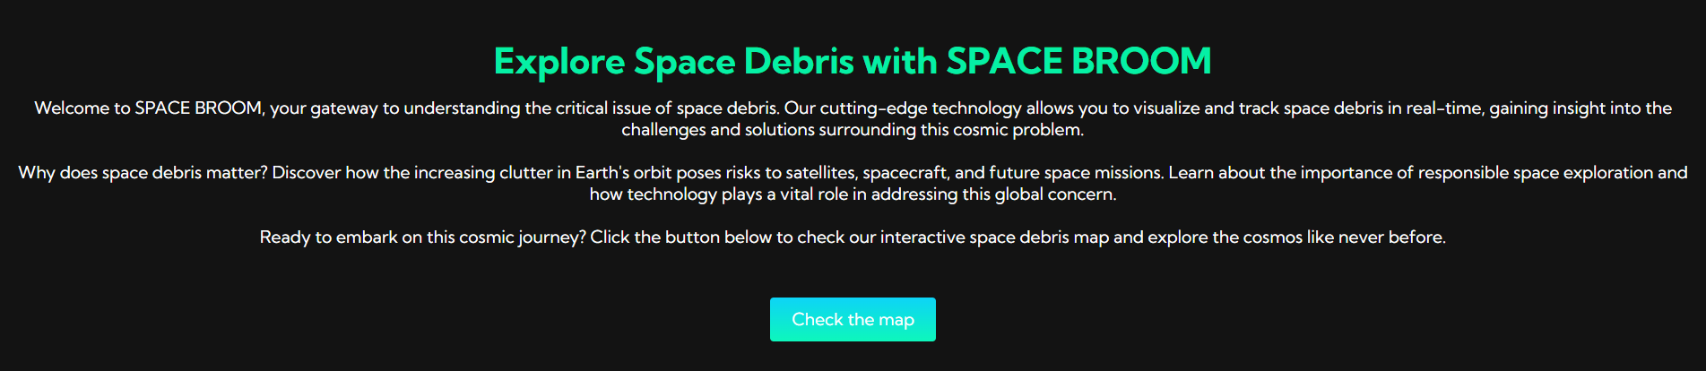
Project page
On the project page, you'll find a comprehensive overview of our initiative to address the space debris problem. Learn about the challenges, objectives, and the technology we aim to develop. To get a closer look at space debris, simply click the 'Check the map' button and explore the interactive 3D space debris map.

Slide 4
MAP
The map page offers an intriguing glimpse into the world of space debris, even though it currently utilizes a random 3D model instead of real data. Unfortunately, we couldn't find a comprehensive database of space debris for accurate visualization. Nevertheless, this interactive 3D model of Earth and space debris provides a captivating experience. You can explore the cosmos, zoom in on Earth, and examine the simulated space debris. While it may not represent real-time data, it serves as a placeholder until we can access a reliable database of space debris for a more accurate portrayal of the cosmic challenge.(Pictures on next slide)

Slide 5
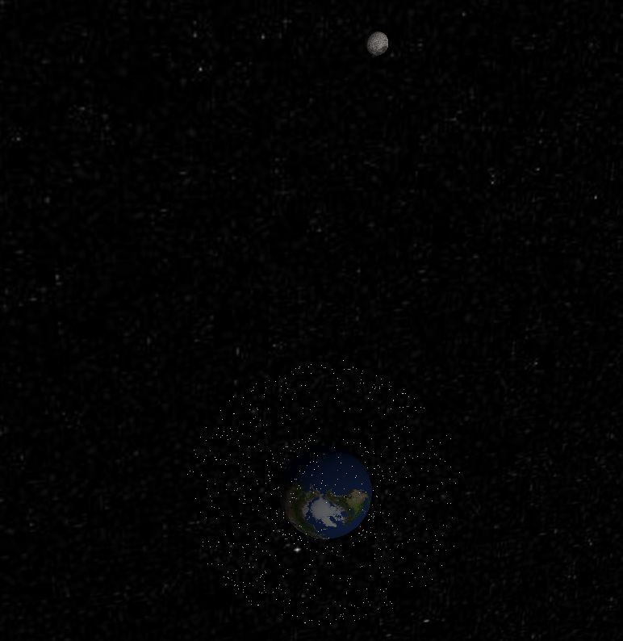
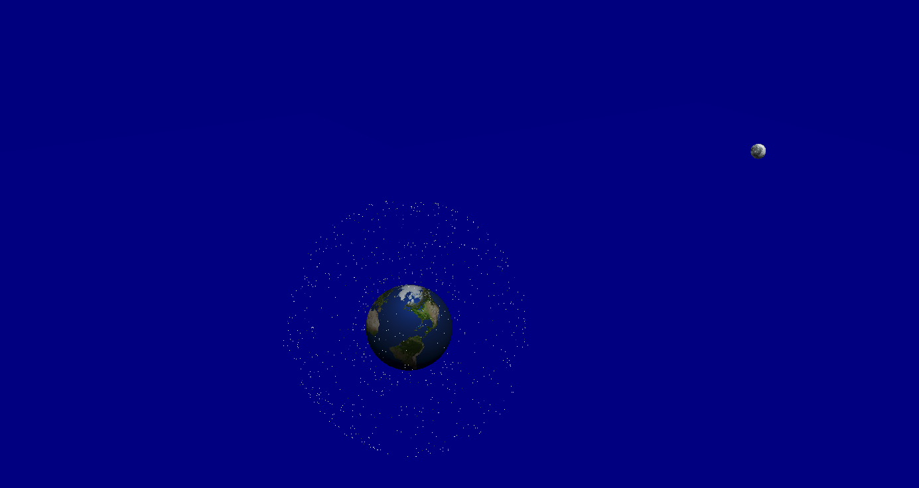

Slide 6
references
Links we used:
Font awesome- used for icons: https://fontawesome.com/icons
unDRAW - main page image: https://undraw.co/illustrations
Pexels - used for the 3 additional pictures: https://www.pexels.com/
Sketchfab - used for the 3D model (credit to federico_unipa (https://sketchfab.com/federico_unipa)): https://sketchfab.com/3d-models/satellites-and-space-debris-around-the-earth-f6b3b5fd88e442cc9d5013a8f3ff6295

